Slide 1

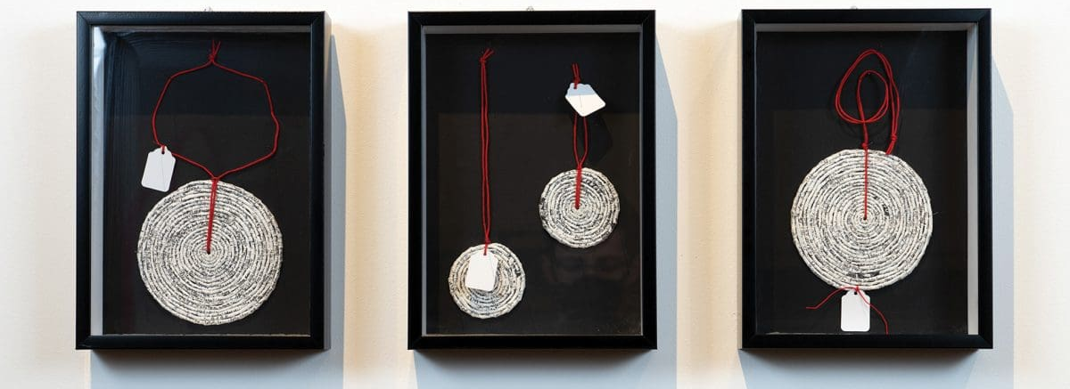

Slide 2
Reflection Activity – Cultural Signals & Conventions
Instructions: Choose one artist from the “Cultural Signals & Conventions” PowerPoint to reflect on. our options are: Teho Ropeyarn, Brian Robinson, Simryn Gill, Jenna Lee. Answer the following questions based on how your chosen artist
How does this artist use codes such as pattern, repetition, symbols, or text to communicate meaning?
How does the artist’s process of developing, researching, reflecting, and resolving shape their final work?
In what ways does the artist’s cultural or personal identity influence the materials, symbols, or language used?
How can you apply similar strategies to express a story, feeling, or place important to you?

Slide 3
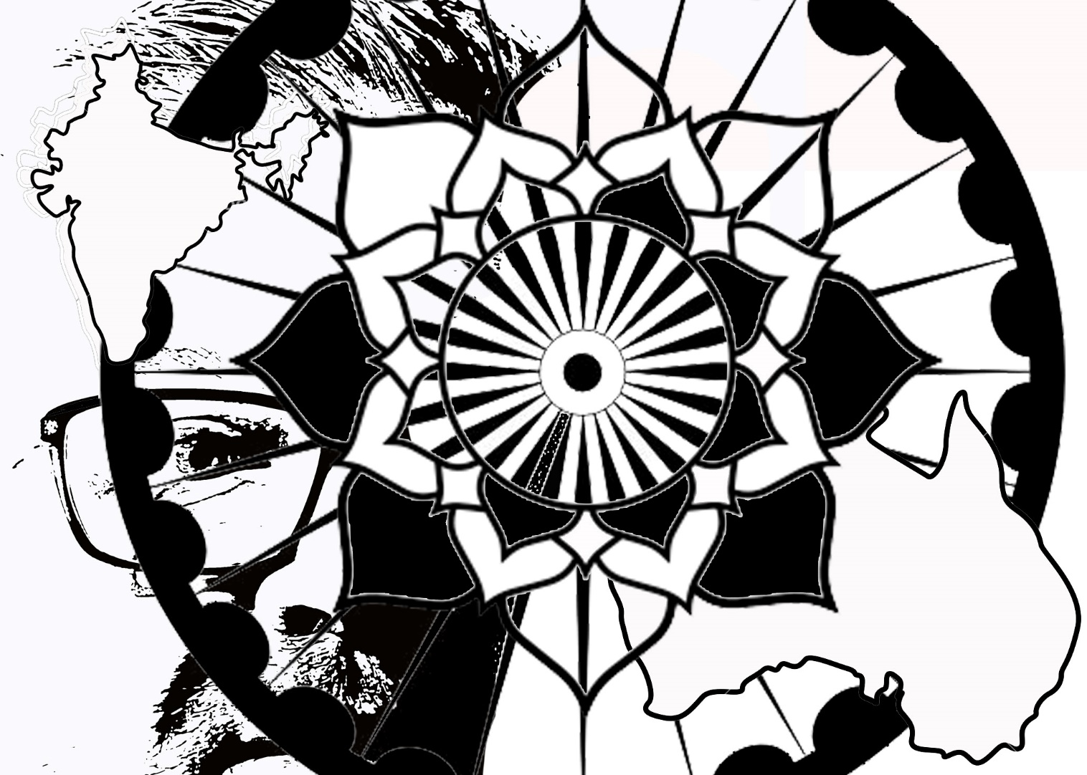
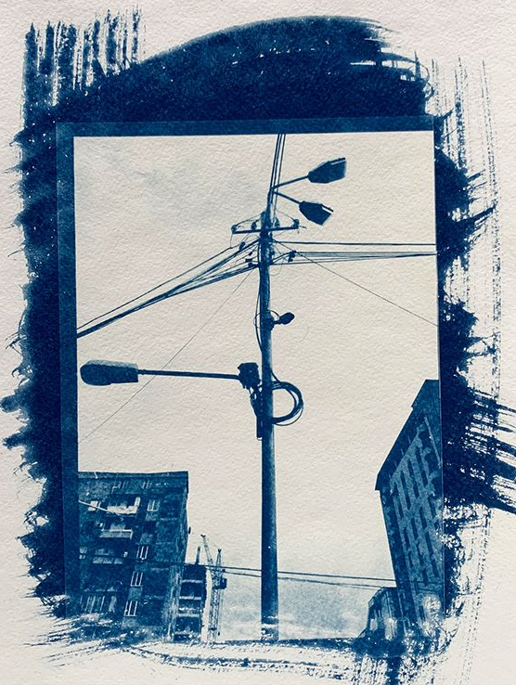
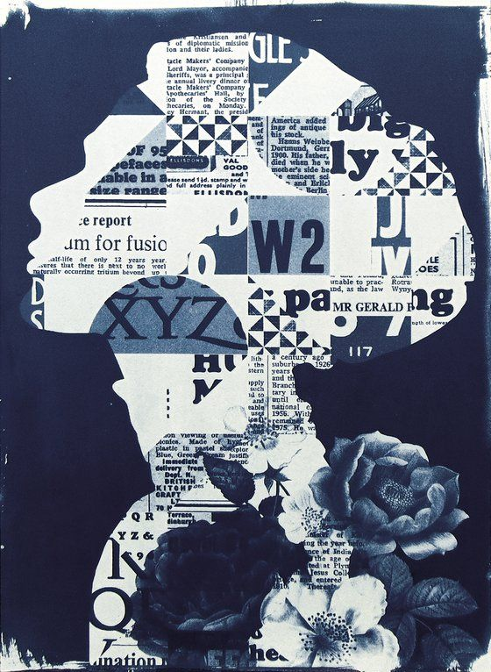
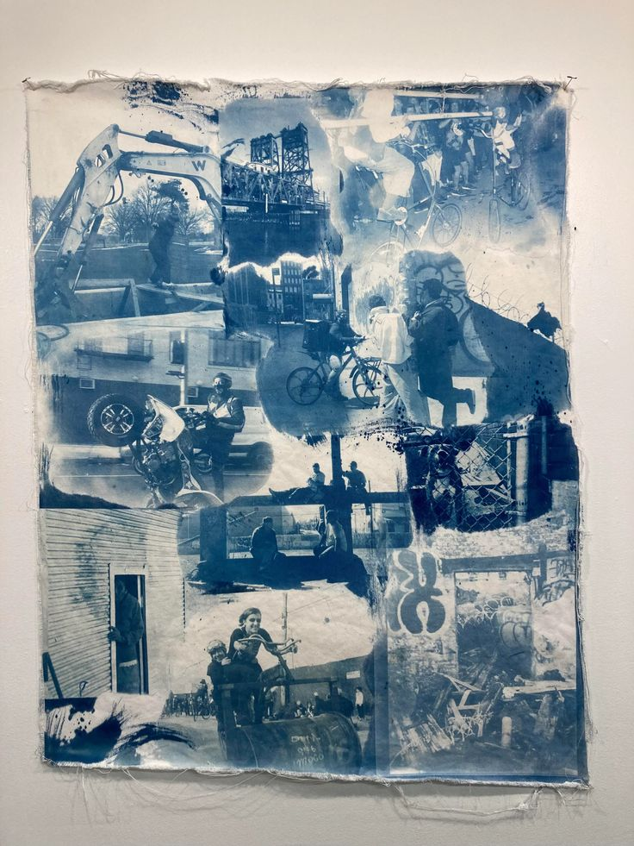
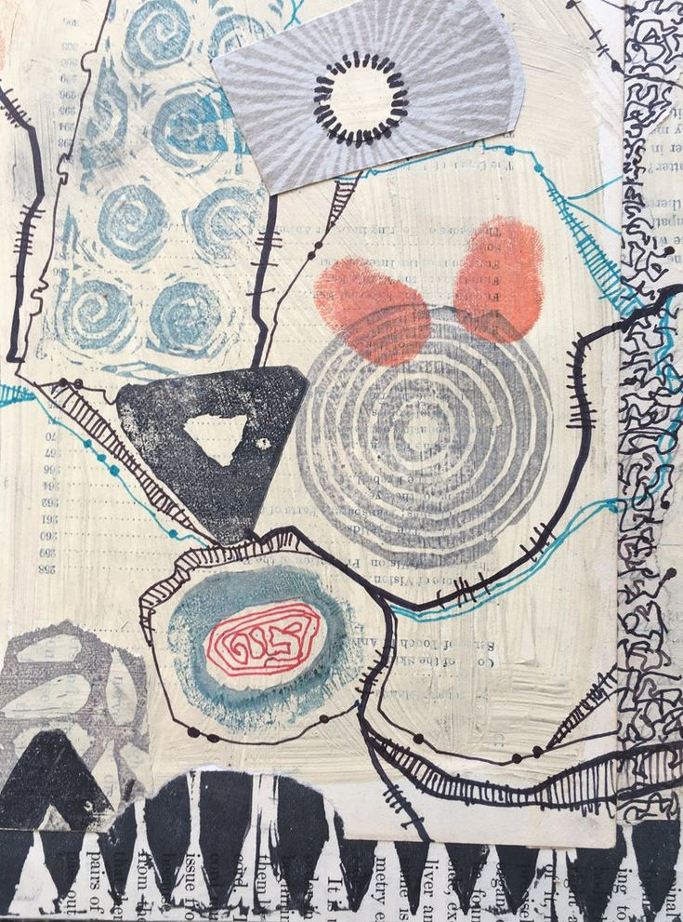
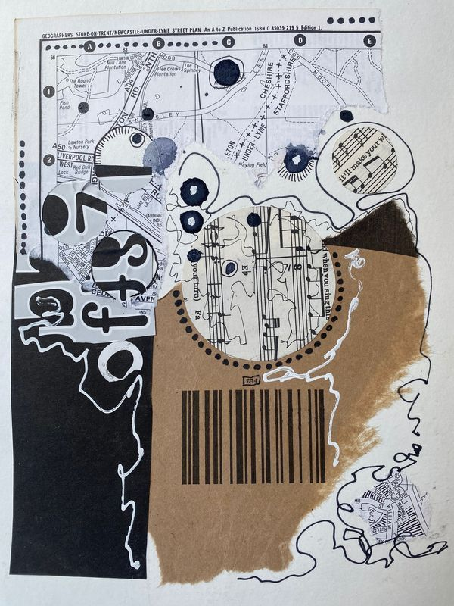
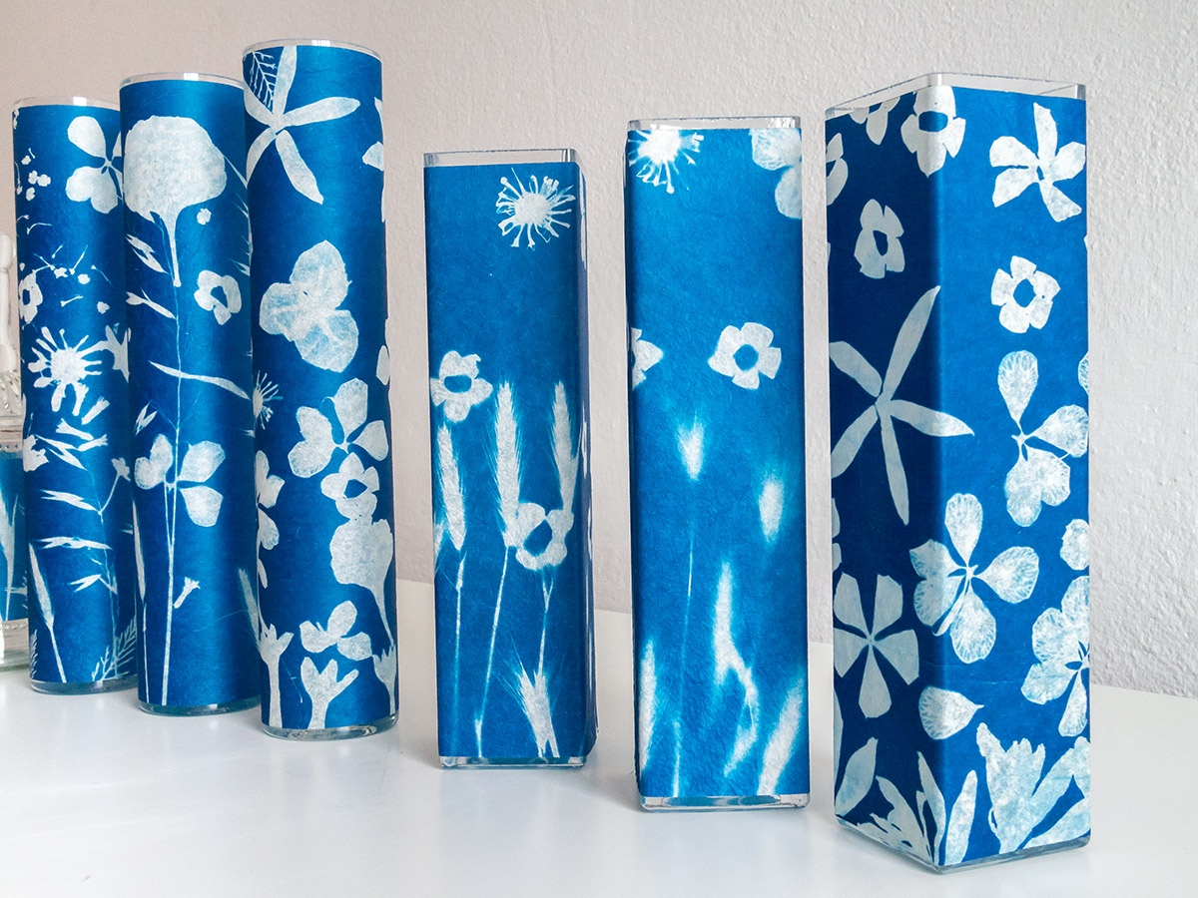
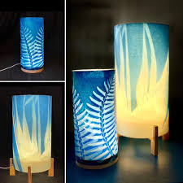
PRACTICAL ACTIVITY
Task:
Combine abstract and symbolic imagery (e.g., animals, icons, patterns, natural forms, maps)
Incorporate text (family words, place names, personal language, script or invented marks)
Focus on pattern, repetition, contrast, negative space, and symbolism to communicate meaning.
Develop a black and white A4 graphic design that reflects aspects of your cultural, community, or personal identity.
Process:
Photocopy or print your design onto A4 acetate transparency.
Coat fabric or paper with cyanotype solution and expose your design using sunlight to create a sunprint.
Wrap your sunprint into a cylindrical form and assemble it as a lantern.
Objective: To explore how cultural identity, memory, and place can be expressed through pattern, repetition, text, and symbolism, using mixed media and light.
What stories live within your place or identity? What materials, marks, or messages help you communicate them visually?
STEP 1: A4 GRAPHIC DESIGN EXAMPLES
STEP2 : CYANOTYPE EXAMPLES (WHAT YOUR GRAPHIC DESIGN WILL LOOK LIKE AFTER TURN INTO A LARGE SCALE NEGATIVE AND EXPOSED IN UV LIGHT ON FABRIC COATED IN CYANOTYPE SOLUTION
STEP 3: END RESULT OF CYANOTYPE LANTERN
Formal Context: Consider how repetition, symmetry, and compositional layout enhance the clarity and rhythm of your pattern. Use contrast, colour harmony, shape reduction, and negative space to refine the symbol into a visually striking design.
Cultural Context: Consider how your work reflects aspects of your personal, community, or cultural identity. Think about how the artists you studied draw on heritage, memory, place, or language, and how you can do the same to express meaning in your mixed media response.

Slide 4
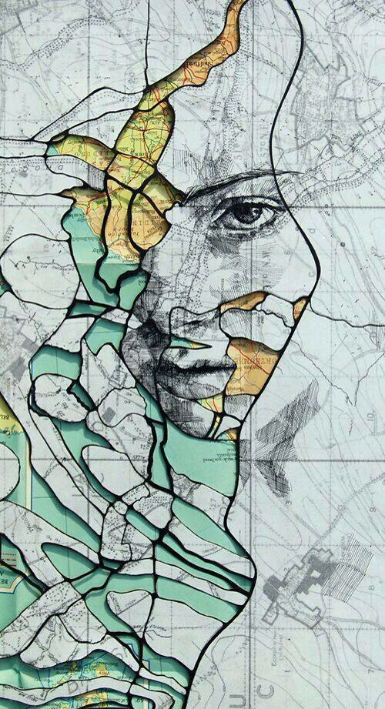
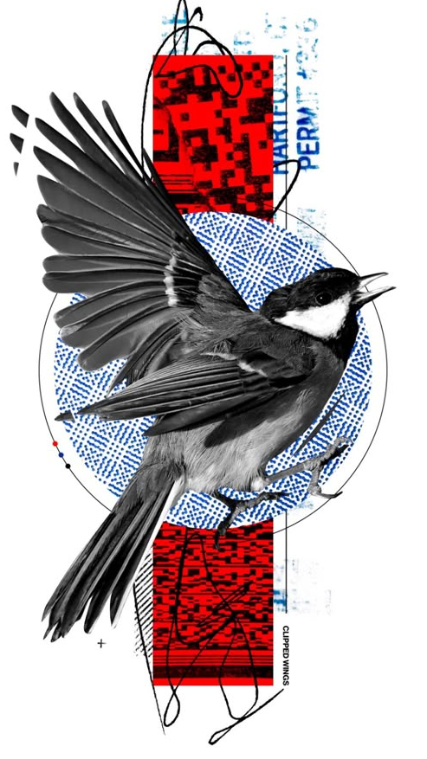
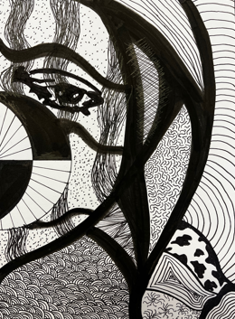

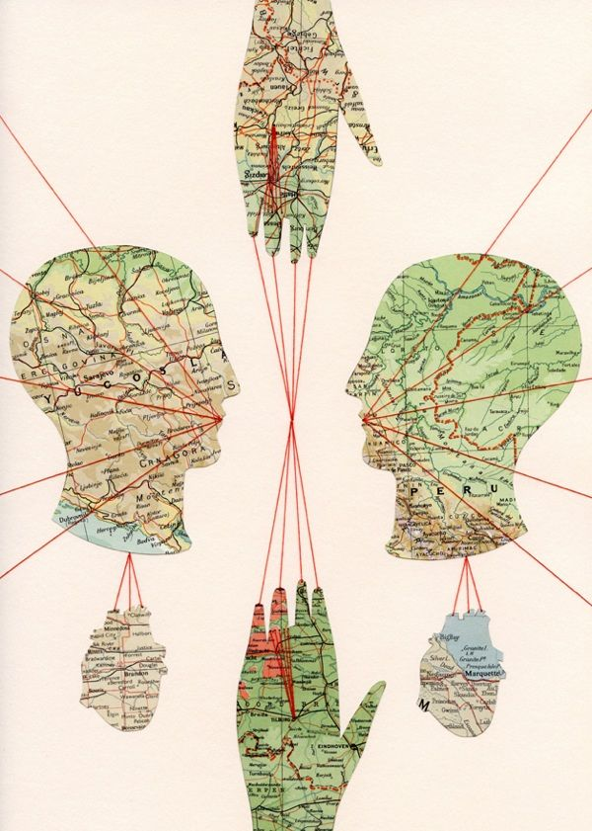
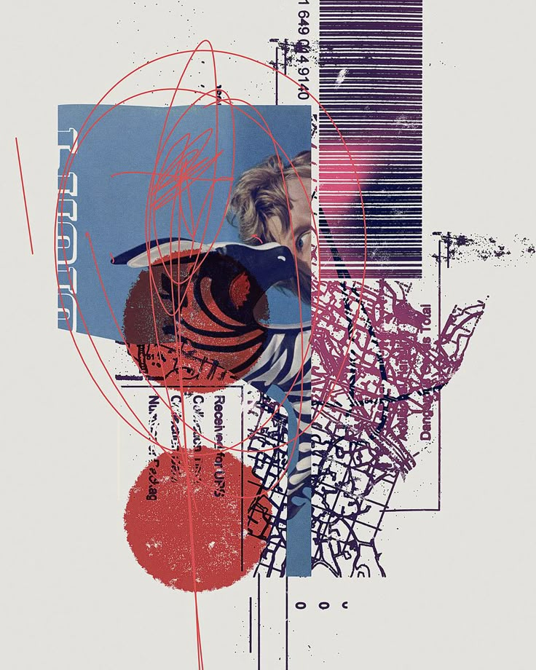
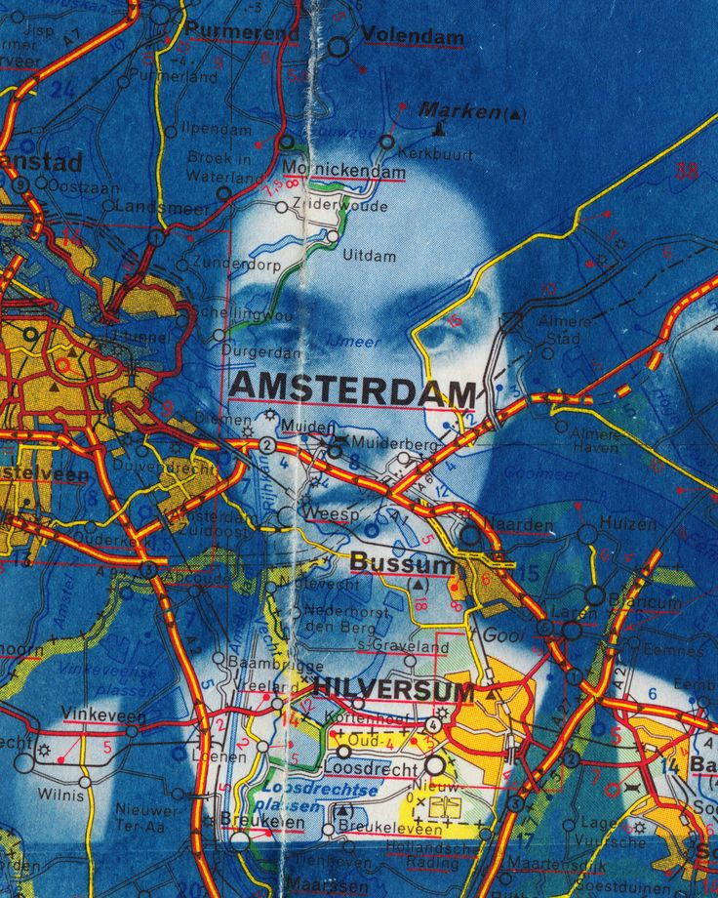

INSPIRATION FOR YOUR GRAPHIC A4 DESIGN

Slide 5
Researching: How did you react to stimulus?
Insert clear image of artwork
Crop the image to frame the work (nothing in the background)
Developing: How did you generate solutions to visual problems? Insert a photograph/s detail of the artwork below
Reflecting: How did you consider ideas and information, media techniques and processes?
Evaluate: How successful was the experiment? Why?

